Slide 1
Introduction to GIT
Ricardo Delfin Garcia
CS 309: Autonomous Intelligent Robotics

Slide 2
What is git?
Version Control System (VCS)
Manages files, versions, distributed copies, etc.
Collaboration
Makes life easier
git != GitHub

Slide 3
Terms
Repository: A git project
Commit: A set of changes you can revert back
Branch: A pointer to a commit

Slide 4
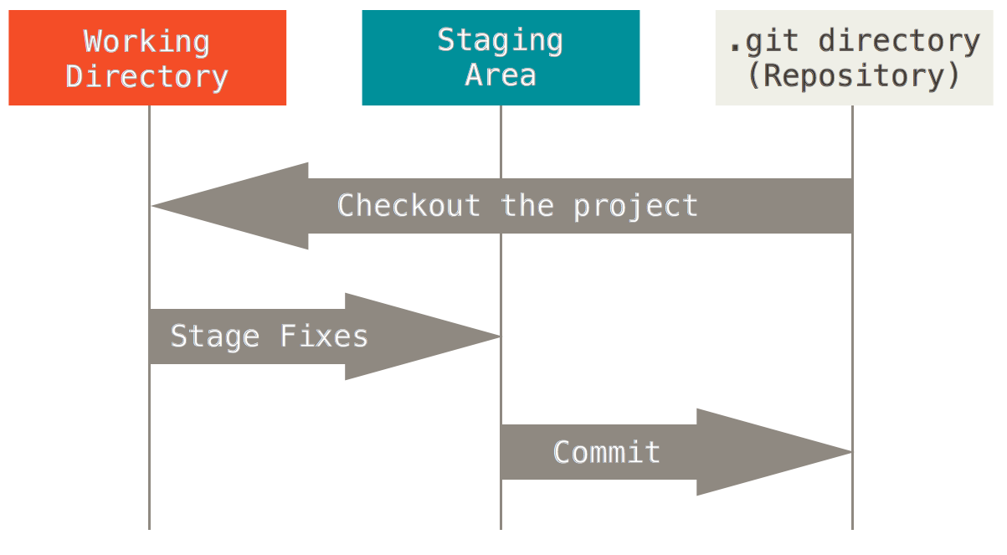
Git Workflow
File.txt
With changes
File.txt

Slide 5
Exercise
Download a fresh copy of Homework 2

Slide 6
Starting a Repository
Create a folder or find your code
Run: git init
To check everything: git status
Questions to ask yourself
Where should I create it?

Slide 7
Making Changes
Change a file
Stage your changes with: git add . OR git add <FILE_NAME>
Commit your changes: git commit –m “<COMMIT MESSAGE>”
Questions to ask yourself
What do I want to stage?
Generally “everything”
What is my commit message?
Make it clear and concise
Notes:
Add an annoying “this is annoying” message to print 10 times a second.

Slide 8
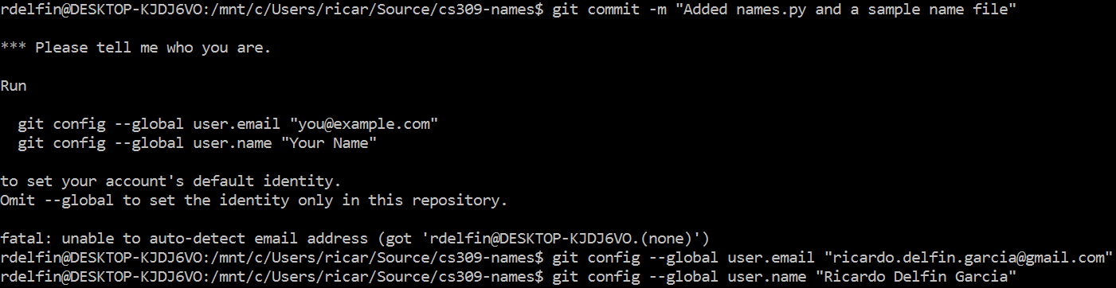
Note on first commit
You might get an error where git asks who you are
Follow the instructions given

Slide 9
Remotes
Remote: Another copy of the repository
Generally on a separate computer/server
Service: GitHub

Slide 10
Adding Remote
Create a new repo in GitHub
Name it “cs309_hw2_<EID>”
git remote add origin https://github.com/<USERNAME>/cs309_hw2_<EID>
Then “connect” master branch to the “origin” remote and push changes:
git pull -u master origin/master
git push

Slide 11
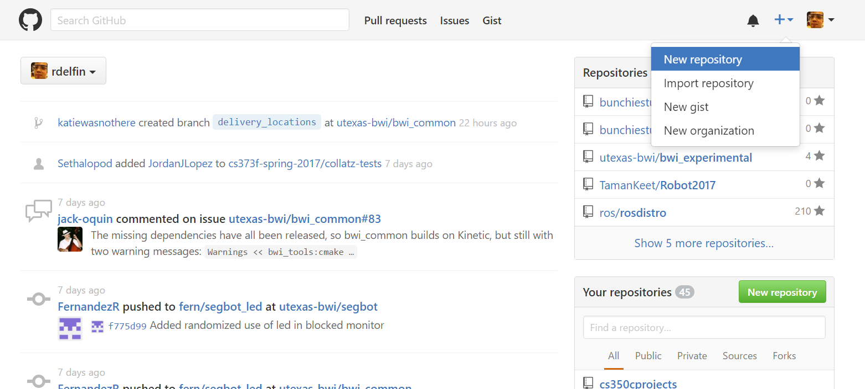
Select New Repository…

Slide 12
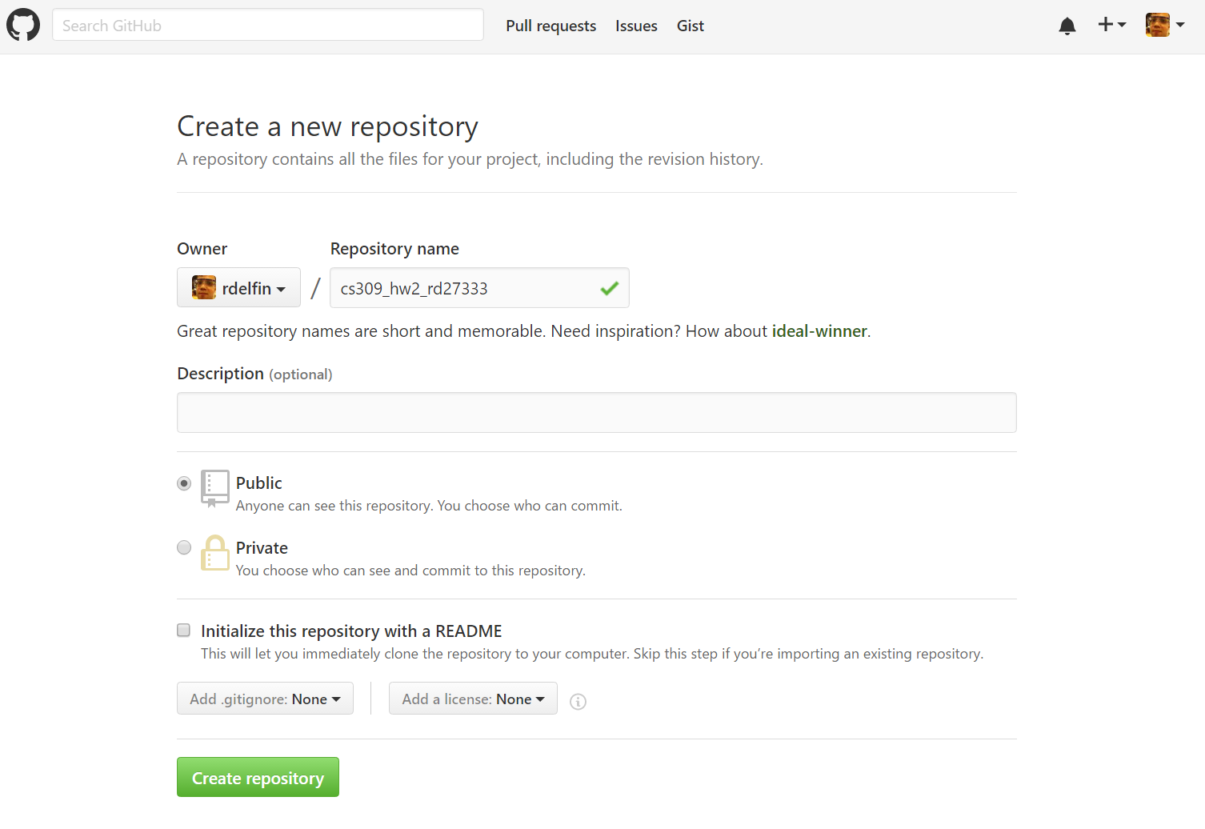
Notes:
The checkbox must be unselected and the two dropdowns must be in none if you’re uploading existing code to GitHub. Otherwise you can mess with them

Slide 13
Branches
Provide an easy way to separate new changes
Switch between branches quickly
Only “merge” when changes are ready

Slide 14
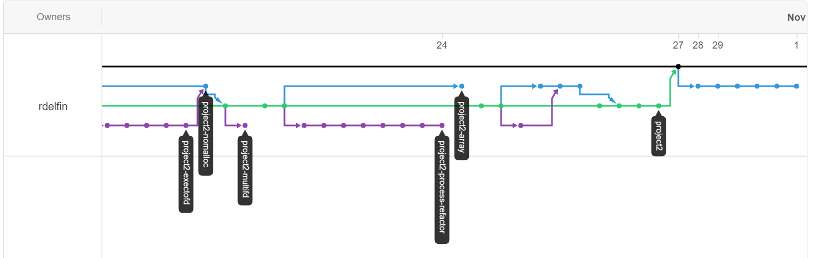
Sample Git Tree

Slide 15
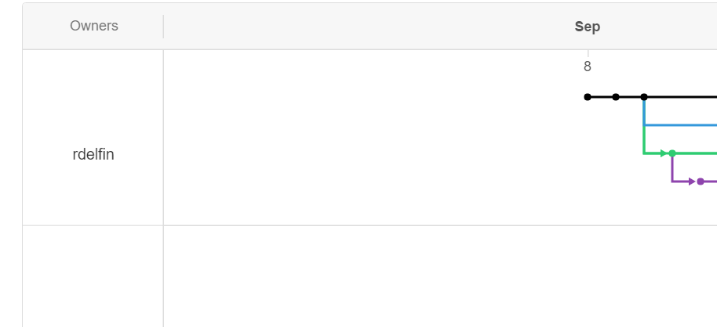
Creating a branch

Slide 16
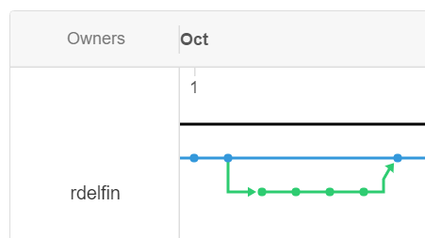
Merging Back

Slide 17
Creating a Branch
Create the branch: git checkout –b <BR_NAME>
Make changes and commit
To switch to a different (existing) branch: git checkout <BR_NAME>
Previous command also works with remote branches
Notes:
Create a branch called: feat/fortytwo, type #include "std_msgs/Integer.h“ ros::Publisher chatter_pub = n.advertise<std_msgs::Integer>("chatter", 1000); std::msgs::Integer msg;
msg.value = 42; chatter_pub.publish(msg);
And commit

Slide 18
Merging into Master
Checkout (switch to) the master branch
Merge second branch into master: git merge <BR_NAME>
Read output! There might be merge conflicts

Slide 19
Sample Git Tree

Slide 20
Solving Merge Conflicts
Check what files had conflict git status
Open the files and fix conflicts
Commit changes
Say you fixed merge conflict in commit message

Slide 21
Pull Requests
Request the owner of a repo to merge your branch
It’s a GitHub term, not git
Ensures people check your code before merge

Slide 22
Pull Request
Get a copy of the code (fork & clone)
Create a new branch
Make changes on the branch
Push all your changes: git push –u origin <BR_NAME>
Create a pull request on the website
Notes:
Fork is for when the repository is not in your account
Here, add another branch: feat/

Slide 23
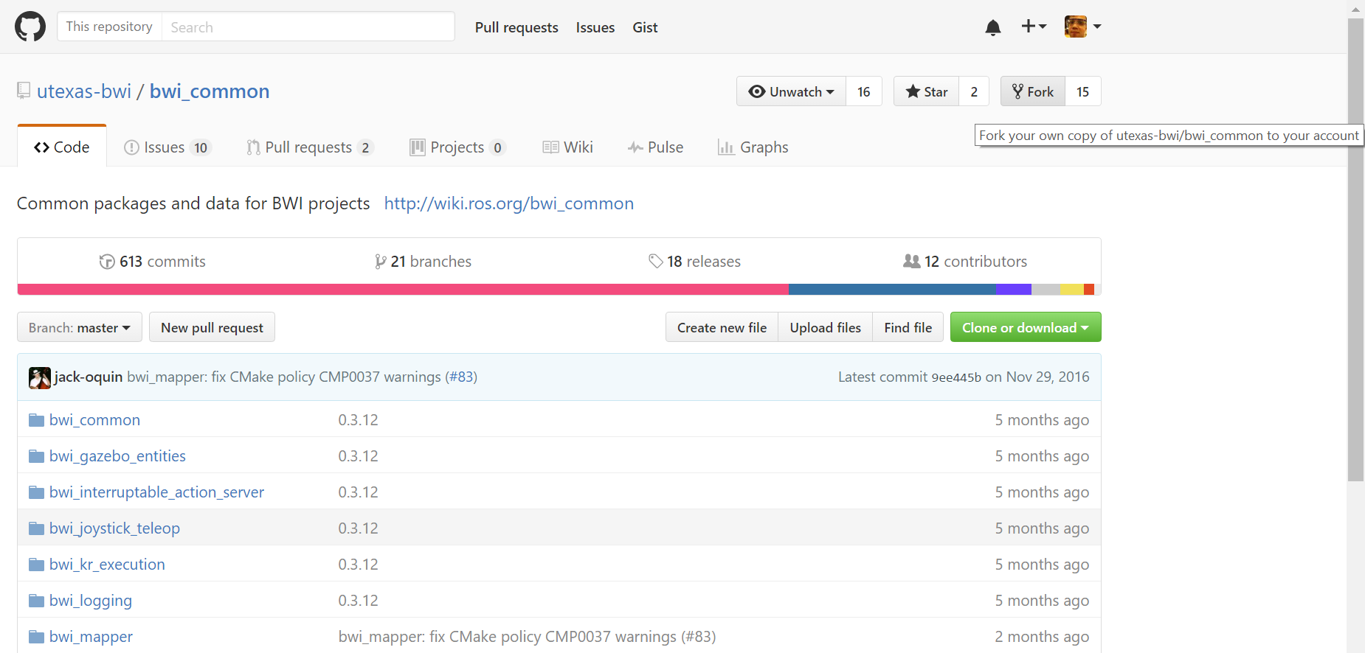
Fork the Repository

Slide 24
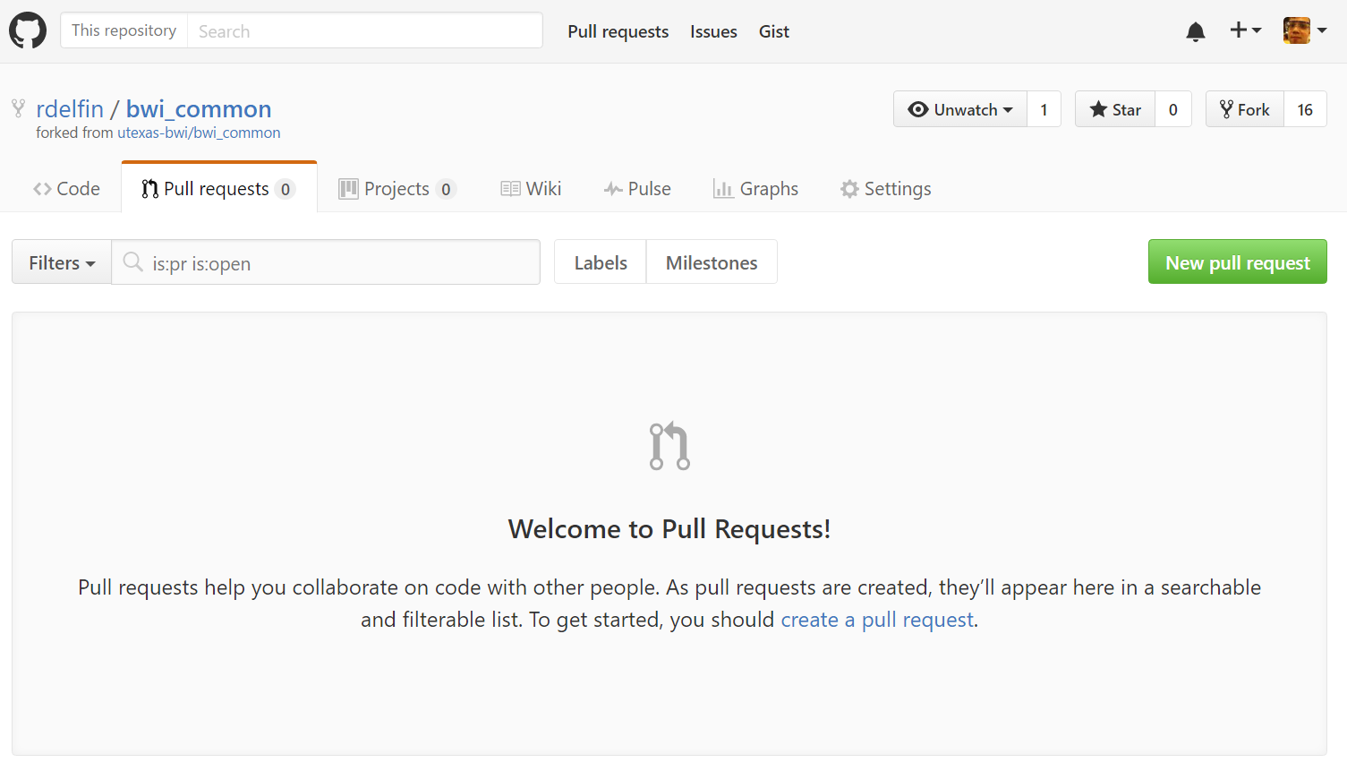
Create Pull Request

Slide 25
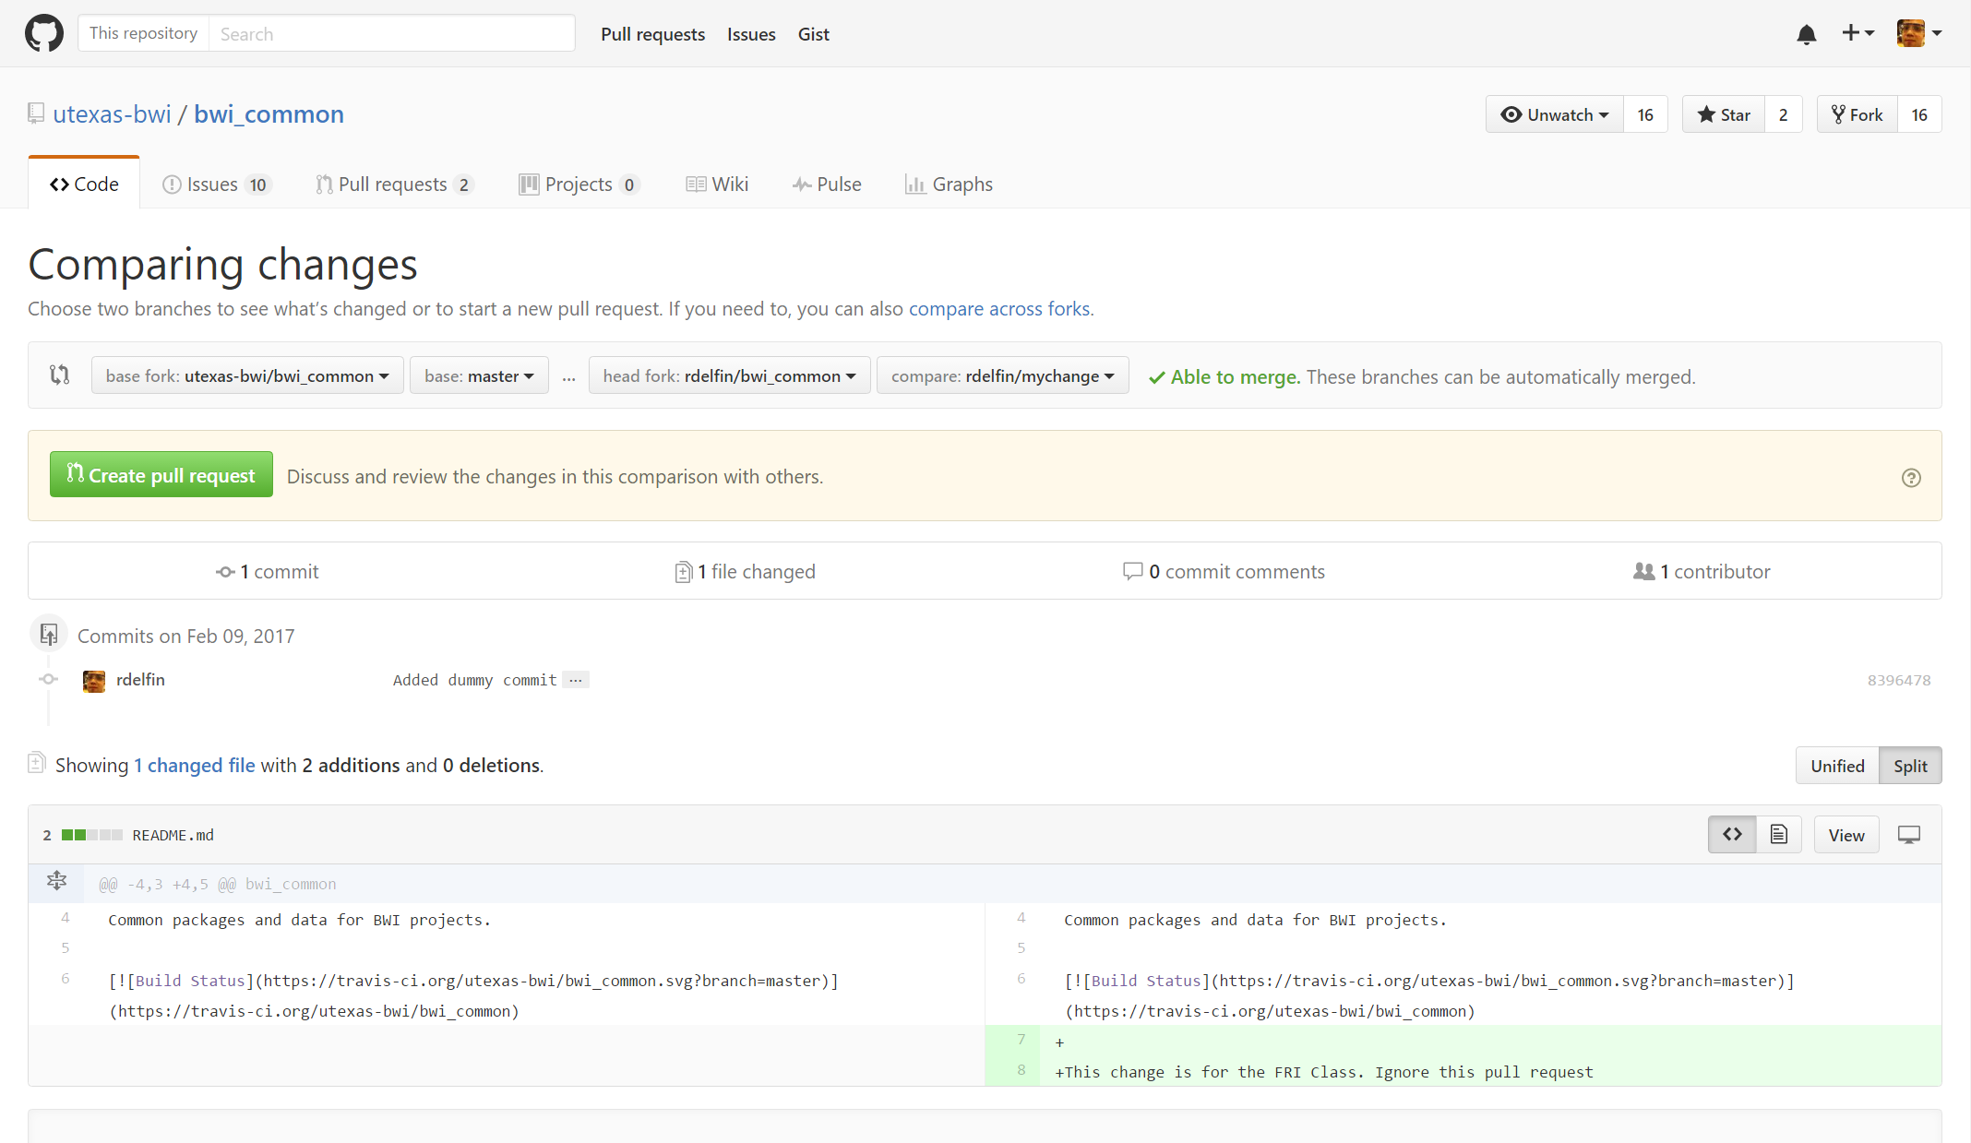
Setting Base and Head Fork

Slide 26
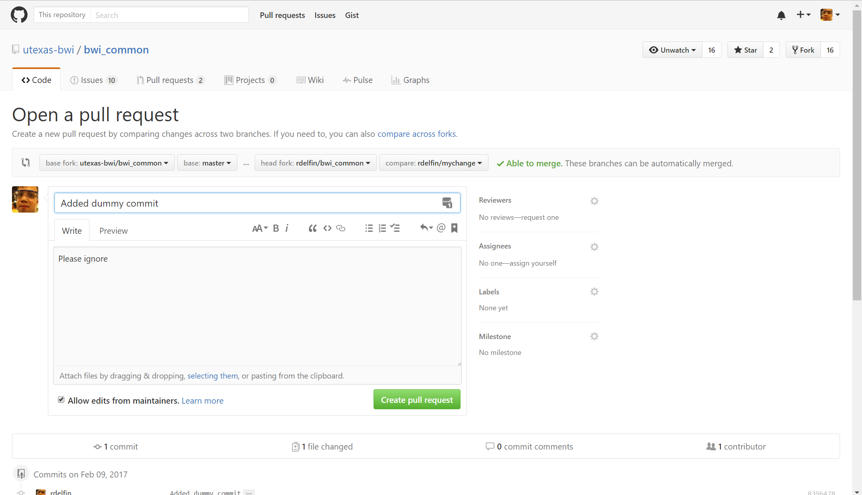
Confirm Creation

Slide 27
A Useful File: .gitignore
List of files/file types that should not be added to repo
Binaries, output, IDE files, etc.
Goes in repo root directory

Slide 28
Final Exercise
Fork the repository
git clone https://github.com/<USERNAME>/cs309-names
Create a new branch called “<EID>”
Add a file in folder “names” called <EID>.txt and put your name plus a new line
Commit and push
Create pull request

